Slide 1


ANAND INSTITUTE OF HIGHER TECHNOLOGY (An Autonomous Institution)
DEPARTMENT OF COMPUTER SCIENCE AND ENGINEERING
MAILOPS CLI E-MAIL MANAGEMENT TOOL
TEAM MEMBERS
1. DHIVAHAR.V (310121104025)
2. ELANTHIRAYAN.E (310121104030)
GUIDE NAME
Mr. A.S Balaji M.E.,(Ph.D) Assistant Professor
1

Slide 2
ANAND INSTITUTE OF HIGHER TECHNOLOGY (An Autonomous Institution)
DEPARTMENT OF COMPUTER SCIENCE AND ENGINEERING
Domain introduction
Literature Papers
Existing system
Problem statement
Objectives & Scope
Proposed system
Architecture
Modules
Screenshots
Conclusion
Future Enhancement
References
AGENDA
2

Slide 3
ANAND INSTITUTE OF HIGHER TECHNOLOGY (An Autonomous Institution)
DEPARTMENT OF COMPUTER SCIENCE AND ENGINEERING
Domain Overview – Email & Cybersecurity
The MailOps-CLI project falls under the Email Management & Cybersecurity domain.
Email is a primary mode of communication, but it suffers from security vulnerabilities like phishing, unauthorized access, and data breaches.
Traditional email clients provide encryption, but they are often complex and resource-heavy.
MailOps-CLI introduces a lightweight, CLI-based approach to email management with enhanced security through encryption and decryption mechanisms.
Why CLI for Email?
Offers faster access without a GUI Reduces resource usage and increases productivity Enables advanced users to manage emails with greater control.
3

Slide 4
ANAND INSTITUTE OF HIGHER TECHNOLOGY (An Autonomous Institution)
DEPARTMENT OF COMPUTER SCIENCE AND ENGINEERING
EXISTING SYSTEM
1
Graphical User Interface (GUI) Based: Relies on a resource-intensive GUI, which can be slower on less powerful machines. Users navigate through multiple screens, which can be time-consuming.
Manual Email Organization: Users must manually sort and organize emails, a process that is inefficient and time-consuming. Basic filtering exists but lacks advanced automation.
Standard Workflow: Standard email features require navigating multiple menus, disrupting workflow. Accessing features like sending and searching emails involves several steps.
High Resource Consumption: Traditional email clients consume significant system resources, reducing overall performance. Running these clients can slow down older or less powerful devices.
Lack of AI-Powered Features: Traditional email clients lack AI-driven features like smart reply generation, tone adjustment, sentiment detection. This absence forces users to respond, and organize emails, leading to repetitive and inefficient workflows.
2
3
4
5
4

Slide 5
ANAND INSTITUTE OF HIGHER TECHNOLOGY (An Autonomous Institution)
DEPARTMENT OF COMPUTER SCIENCE AND ENGINEERING
PROBLEM STATEMENT
1
The current email clients are resource-intensive, slow, and lack built-in security. Running these clients on older or low-end devices significantly impacts performance.
Users require a lightweight, fast, and secure email management tool that optimizes workflow without excessive system resource consumption.
Traditional email clients do not support voice messages, making it difficult for users to send quick, voice-based communications.
There is no AI-powered summarization or generation feature in existing clients, requiring users to manually go through long email threads and compose responses.
There is a need for a command-line alternative with encryption capabilities to ensure better privacy, efficiency, and automation in email management.
2
3
4
5
5

Slide 6
ANAND INSTITUTE OF HIGHER TECHNOLOGY (An Autonomous Institution)
DEPARTMENT OF COMPUTER SCIENCE AND ENGINEERING
OBJECTIVES
1
Develop a CLI-based email management tool to provide a lightweight, efficient alternative for sending, receiving, and organizing emails without relying on a GUI.
Implement AI-powered email summarization to extract key information from lengthy email threads and generate concise summaries. This helps users quickly grasp important points without reading the entire conversation.
2
SCOPE
1
Enhanced Email Management: MailOps-CLI streamlines sorting, filtering, and organizing emails across Gmail and Outlook with powerful command-line efficiency.
AI-Powered Features: Smart reply generation, tone adjustment, sentiment detection, and real-time translation improve communication speed and quality.
2
6

Slide 7
ANAND INSTITUTE OF HIGHER TECHNOLOGY (An Autonomous Institution)
DEPARTMENT OF COMPUTER SCIENCE AND ENGINEERING
The Proposed System: MailOps-CLI
Command-Line Interface
Advanced Email Organization
Efficient Workflow
Eliminates the need for a resource-intensive GUI, offering a faster and more efficient email management experience.
Automates email sorting, searching, and flagging for better organization.
Allows quick access to email features (sending, reading, starring, searching) via simple commands, improving productivity.
Speed & Efficiency
Encryption & Security
Seamless Integration
Reduce the time spent on manual email management tasks.
Integrates encryption and decryption features to protect sensitive messages, ensuring secure communication.
Works with major email providers like Gmail and Outlook, enabling smooth email access without complex setups.
AI-Powered Email Enhancements:
Leverages advanced AI to generate smart replies, improve subject lines, adjust tone, detect sentiment, and provide real-time translation—enhancing communication speed and effectiveness.
7

Slide 8
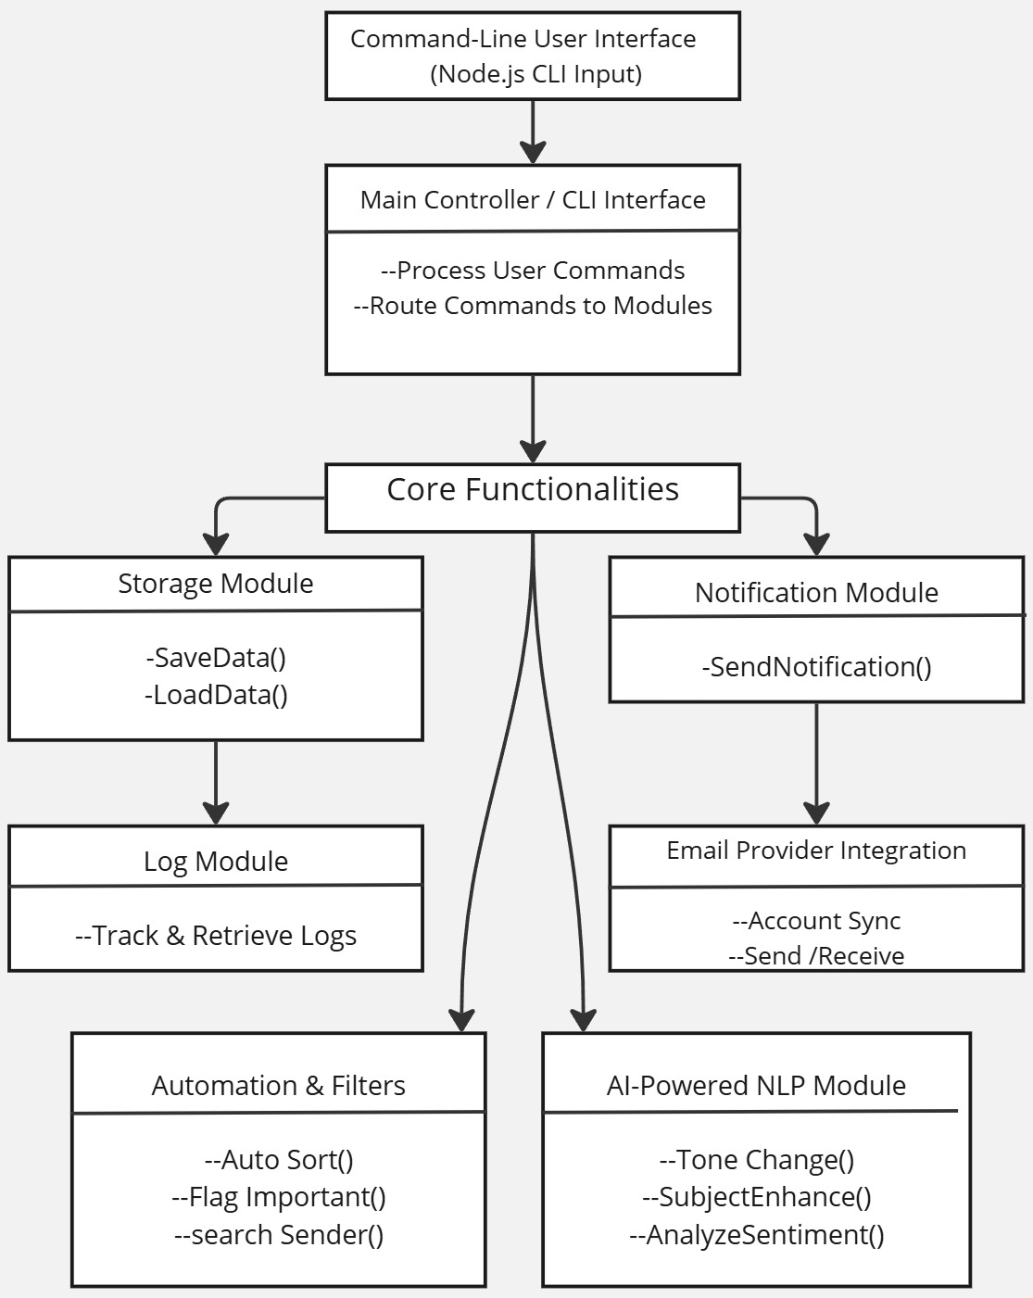
ANAND INSTITUTE OF HIGHER TECHNOLOGY (An Autonomous Institution)
DEPARTMENT OF COMPUTER SCIENCE AND ENGINEERING
Architecture
8

Slide 9
ANAND INSTITUTE OF HIGHER TECHNOLOGY (An Autonomous Institution)
DEPARTMENT OF COMPUTER SCIENCE AND ENGINEERING
MODULES
1
Email Retrieval Module: Fetches emails from connected platforms like Gmail and Outlook, allowing users to view and filter messages directly from the command line.
Email Sending Module: Enables quick and efficient email composition and dispatch with AI-powered enhancements like smart replies and tone adjustment.
Storage Module: Securely stores email metadata, drafts, and logs for quick access and efficient management of historical communications.
Notification Module: Provides real-time command-line alerts for new emails and important updates, ensuring users stay informed without switching interfaces
2
3
4
9

Slide 10
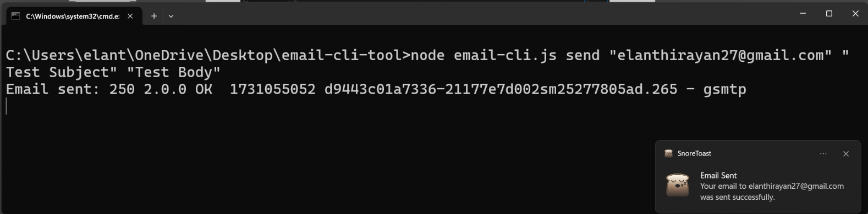
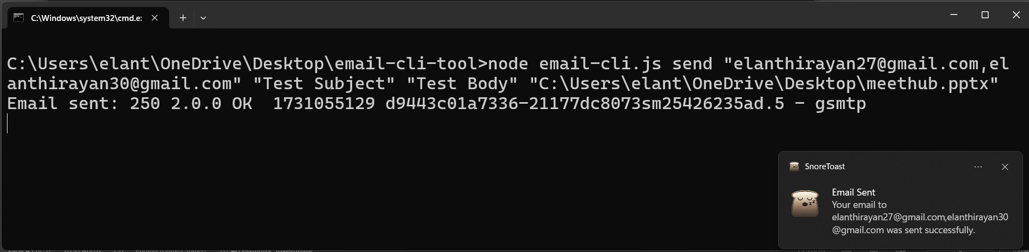
ANAND INSTITUTE OF HIGHER TECHNOLOGY (An Autonomous Institution)
DEPARTMENT OF COMPUTER SCIENCE AND ENGINEERING
SCREENSHOTS
Sending Mail Single or Multiple people
Sending mail with Attachments
10

Slide 11
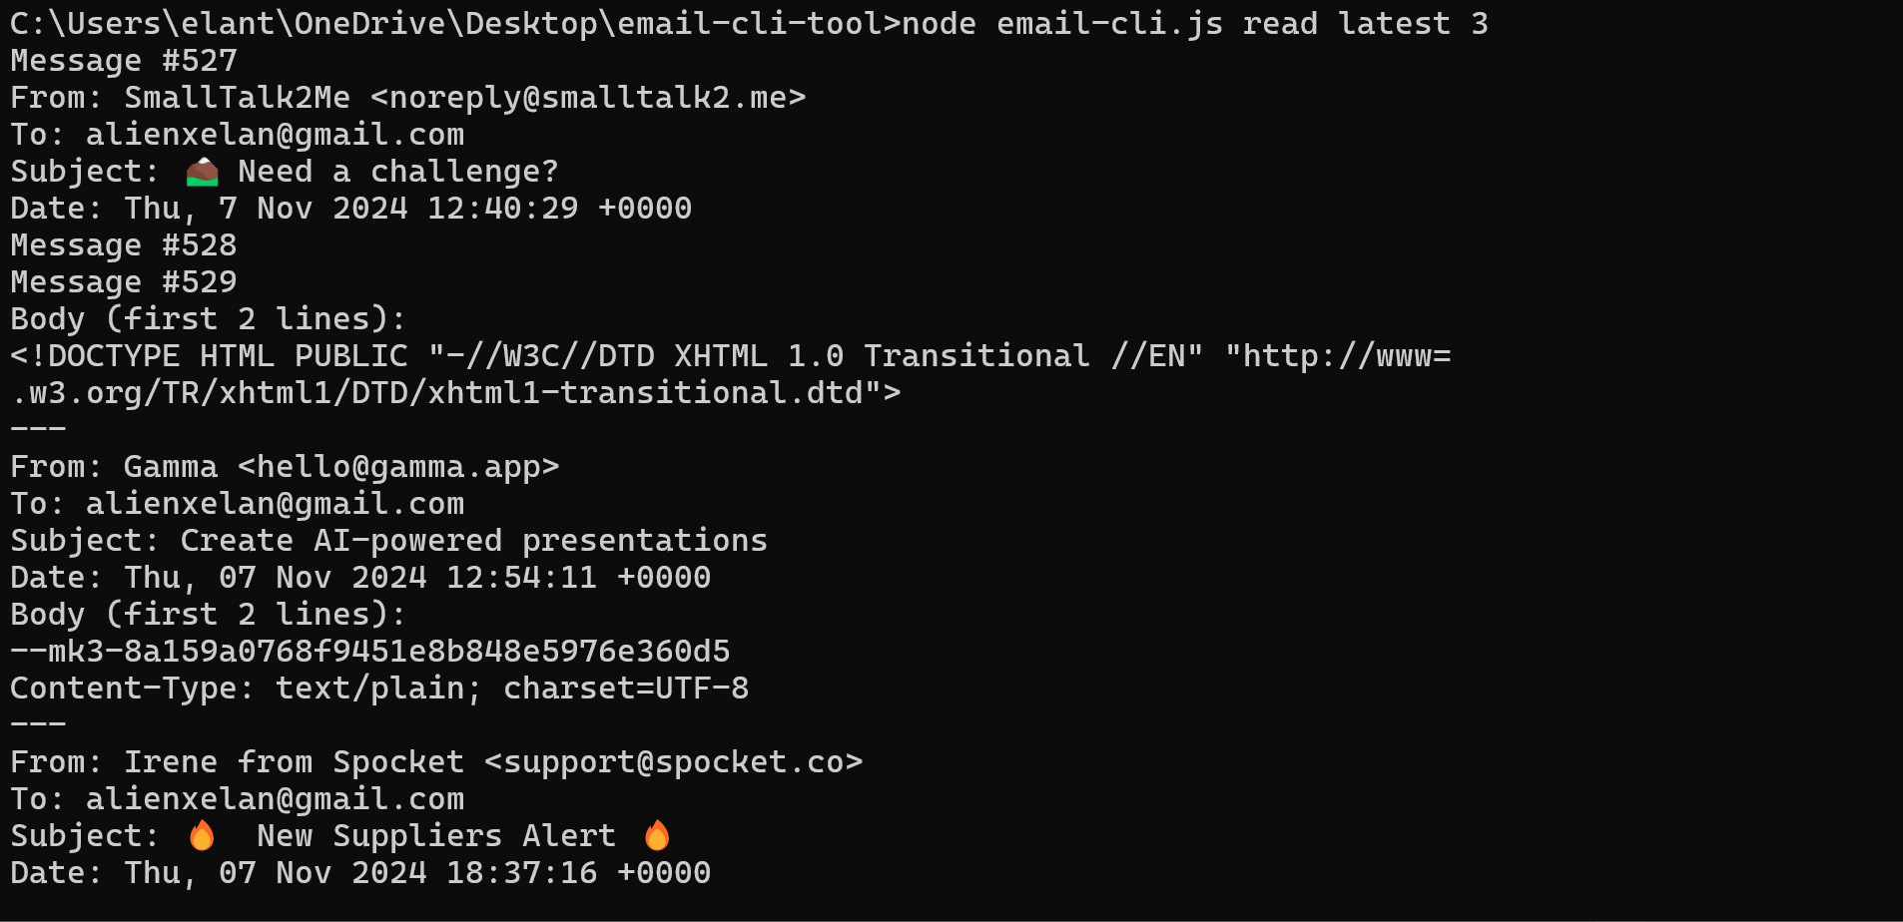
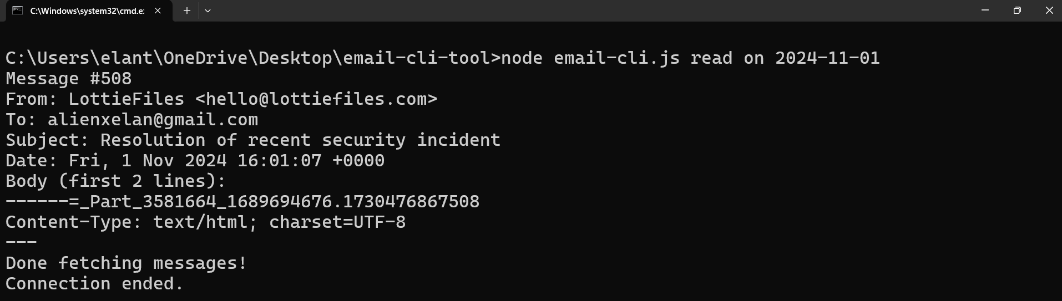
ANAND INSTITUTE OF HIGHER TECHNOLOGY (An Autonomous Institution)
DEPARTMENT OF COMPUTER SCIENCE AND ENGINEERING
Read recent mails
Read Mails on Date
11

Slide 12
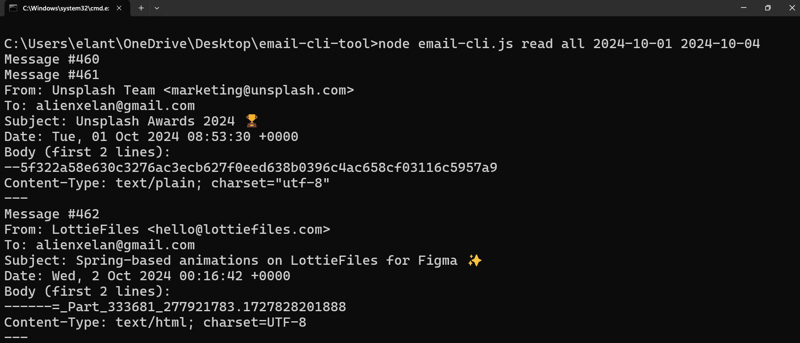
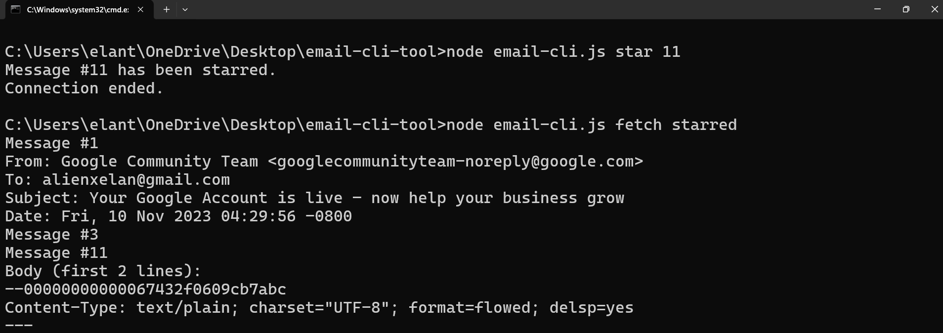
ANAND INSTITUTE OF HIGHER TECHNOLOGY (An Autonomous Institution)
DEPARTMENT OF COMPUTER SCIENCE AND ENGINEERING
Read Mails on Date Range
Set & Fetch Star Mails
12

Slide 13
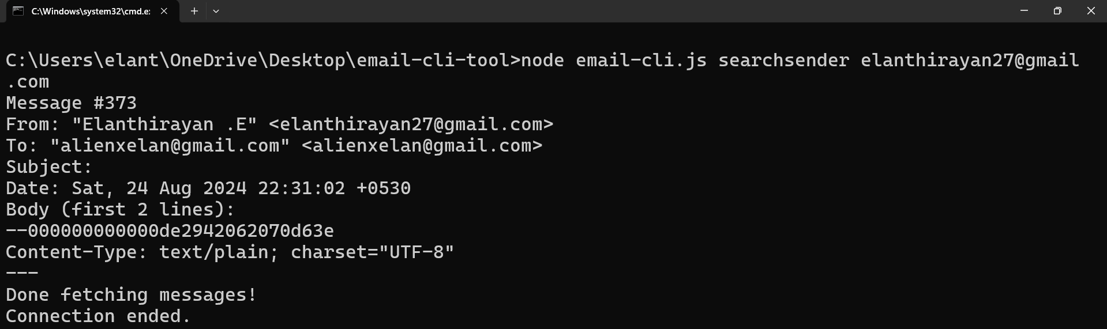
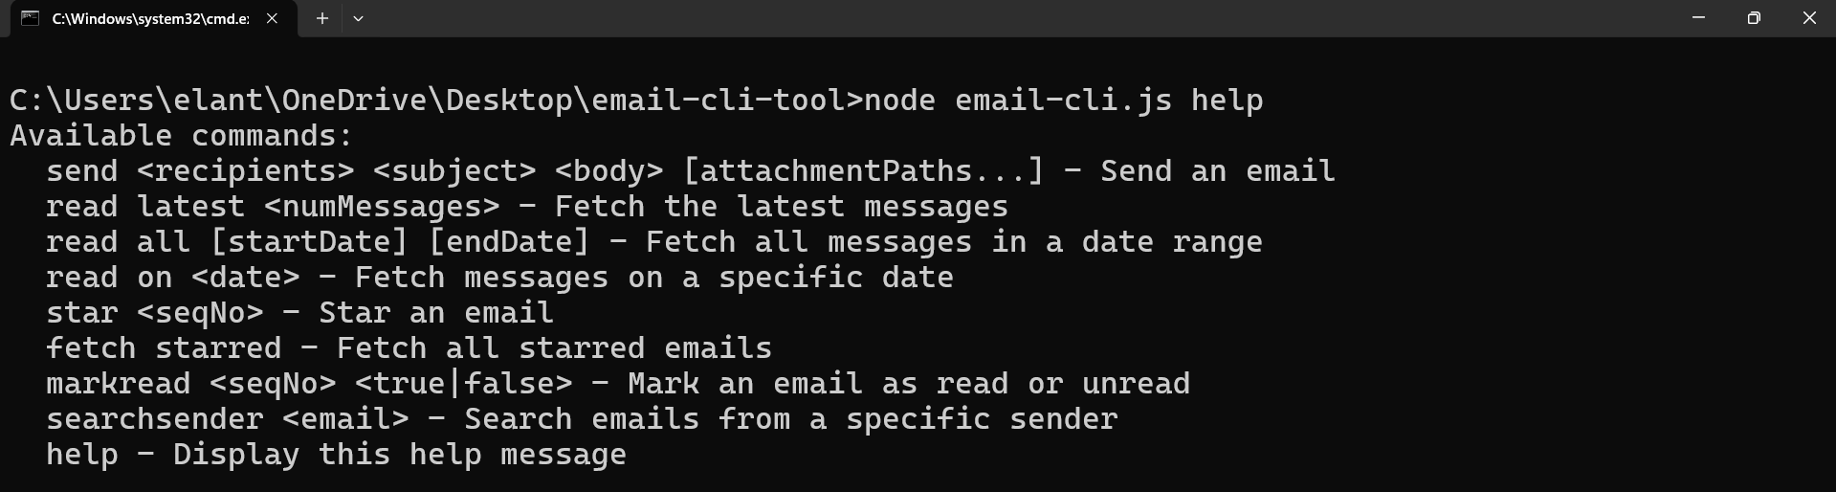
ANAND INSTITUTE OF HIGHER TECHNOLOGY (An Autonomous Institution)
DEPARTMENT OF COMPUTER SCIENCE AND ENGINEERING
Search Sender by Mail
Help Commands
13

Slide 14
ANAND INSTITUTE OF HIGHER TECHNOLOGY (An Autonomous Institution)
DEPARTMENT OF COMPUTER SCIENCE AND ENGINEERING
CONCLUSION
1
Enhanced Email Management with AI Capabilities: Integrates core functionalities like sending, receiving, smart filtering, and management through a command-line interface, now enriched with AI-powered features such as tone conversion, subject enhancement, email summarization, and sentiment analysis.
High Performance and Efficient Processing: Optimized for bulk operations with minimal latency, leveraging Hugging Face NLP models for intelligent content processing and seamless transformation during communication tasks.
User-Friendly CLI Interaction and Robust Testing: Command-line interface supported by clear documentation, intuitive commands, and robust error handling, ensuring smooth adoption and reliable performance across various platforms.
2
3
14

Slide 15
ANAND INSTITUTE OF HIGHER TECHNOLOGY (An Autonomous Institution)
DEPARTMENT OF COMPUTER SCIENCE AND ENGINEERING
FUTURE ENHANCEMENT
1
Automated Email Responses and Analytics: Introducing automated email replies based on criteria like keywords or sender details, along with advanced analytics to track metrics such as open rates and response times, improving email efficiency and user insights.
Enhanced Security Features and Multi-Platform Support:
Introducing end-to-end encryption, spam filtering, phishing detection, and expanding multi-platform support, including mobile compatibility, to ensure better security and flexibility for users on-the-go.
User-Friendly CLI Interaction and Robust Testing: Command-line interface supported by clear documentation, intuitive commands, and robust error handling, ensuring smooth adoption and reliable performance across various platforms.
2
3
15

Slide 16
ANAND INSTITUTE OF HIGHER TECHNOLOGY (An Autonomous Institution)
DEPARTMENT OF COMPUTER SCIENCE AND ENGINEERING
REFERENCES
1. Cecchinato, M. E. and Bird, J. Cox, A. L. ''Personalised email tools
solution to email overload?'' in Personalizing Behavior Change
Technologies : CHI (2024) Workshop, ACM Conference on Human
Factors in Computing Systems (CHI): Toronto, Canada.
2. J. Doe and R. Smith, "Email Management and Strategies for Improve
ment, "TechPublishing,2020,doi:10.1016/j .techpub.2020.04.001.
3. Hu, L. ''A Design of an SMTP Email Server, '' Journal of Emerging
Research in Applied Science and Engineering Technology, vol. 8, no.
4, pp 7932, (2024), doi: 10.26689/jera.v8i4.7932.
4. Kachole, A. ''Email Management Platform,'' International Journal
for Research in Applied Science and Engineering Technology,
vol. 11, no. 2, pp. 456-461, (2024).
5. R. Bhuvaneswari and P. R. Tharaniesh, "Exploring ChatGPT for Email Content Compression and Summarization," 2023 4th International Conference on Communication, Computing and Industry 6.0 (C216), pp. 01–07, 2023.
16

Slide 17
ANAND INSTITUTE OF HIGHER TECHNOLOGY (An Autonomous Institution)
DEPARTMENT OF COMPUTER SCIENCE AND ENGINEERING
THANK YOU…
17

